Slide 2
PROJECT MANAGEMENT TOOLS
MIGRATION FROM MONDAY.COM
Prepared by
INSERT DATE | Proprietary & Confidential

Slide 3
AGENDA
STEPS OF PROJECT MANAGEMENT TOOL SELECTION
1
UNDERSTANDING THE REQUIREMENT
Migration from Monday.com
5
ABOUT THE TOOL
Overview and Pricing of the Tool
2
REQUIREMENT CRITERIA
Reaquired and Nice-to-have features
6
MIGRATION METHODS
Compatibility with Monday.com
3
COMPARISON OF PM TOOLS
Rating the PM tools
7
CONCLUSION
Information about other tools.
4
RECOMMENDATION OF TOOL
Top two PM tools

Slide 4



UNDERSTANDING THE REQUIREMENT
BUSINESS REQUIREMENT

Slide 5
REQUIREMENT CRITERIA
REQUIRED AND NICE-TO-HAVE FEATURES
REQUIREMENTS | FOCUS | PRIORITY
Intuitive Kanban View | Project Management | Required
Simplified Bulk Change | Project Management | Nice-to-Have
Client Status Reporting | Project Management | Nice-to-Have
Helpful Question Community | Project Management | Nice-to-Have
Ease of Historical Task Search | Project Management | Nice-to-Have
Ease of Migrating from Monday.com | Project Management | Nice-to-Have
Capacity/Sprint/Velocity Reporting | Project Management | Nice-to-Have
Track Team Members Capacity/Volume | Project Management | Nice-to-Have
Robust Dependent Task/Story Management | Project Management | Required
Milestone/Epic/Project/Story Structure | Project Management | Required
DUO Multi Factor Authentication | UI/UX | Nice-to-Have
Cloud-Hosted and Accessible via a browser | UI/UX | Required
Intuitive Navigation (Easy to Search) | UI/UX | Required
Multiple Views (Backlog, Kanban, Sprint boards) | UI/UX | Nice-to-Have
GitHub Integration | Integration | Nice-to-Have
Workflow Automation is intuitive | Integration | Nice-to-Have
SCORE SCALE
DESCRIPTION | SCORE
Does Not Meet | 0
Meets with Workaround | 1
Meets Requirement | 2
Exceeds Requirement | 3

Slide 6
ANALYSIS OF PM TOOLS
RATING THE PM TOOLS
Tools For Comparison
Monday
JIRA/Confluence
Shortcut
KanbanFlow
Kanbanize
Notion
Methods of Analysis and Rating
Created Dummy Accounts
Replicated Project Dashboard
Demo Videos and Tutorials
Call with Vendors
Rating as per requirement

Slide 7
COMPARISON OF TOP TWO TOOLS
COMPARISON OF JIRA AND SHORTCUT

Slide 8
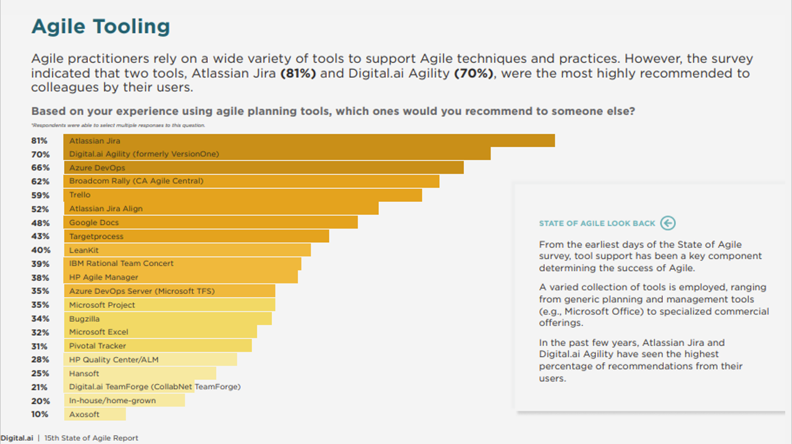
15TH ANNUAL STATE OF AGILE REPORT
GLOBAL STATE OF ENTERPRISE AGILE IN 2021

Slide 9
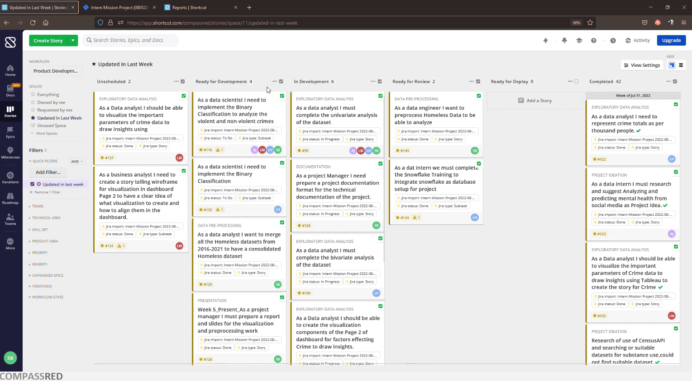
COMPARISON OF TOP TWO TOOLS
COMPARISON OF JIRA AND SHORTCUT
Board and List
Multiple Owners
Dependency
RoadMap
Reports
Milestones
Epic

Slide 10
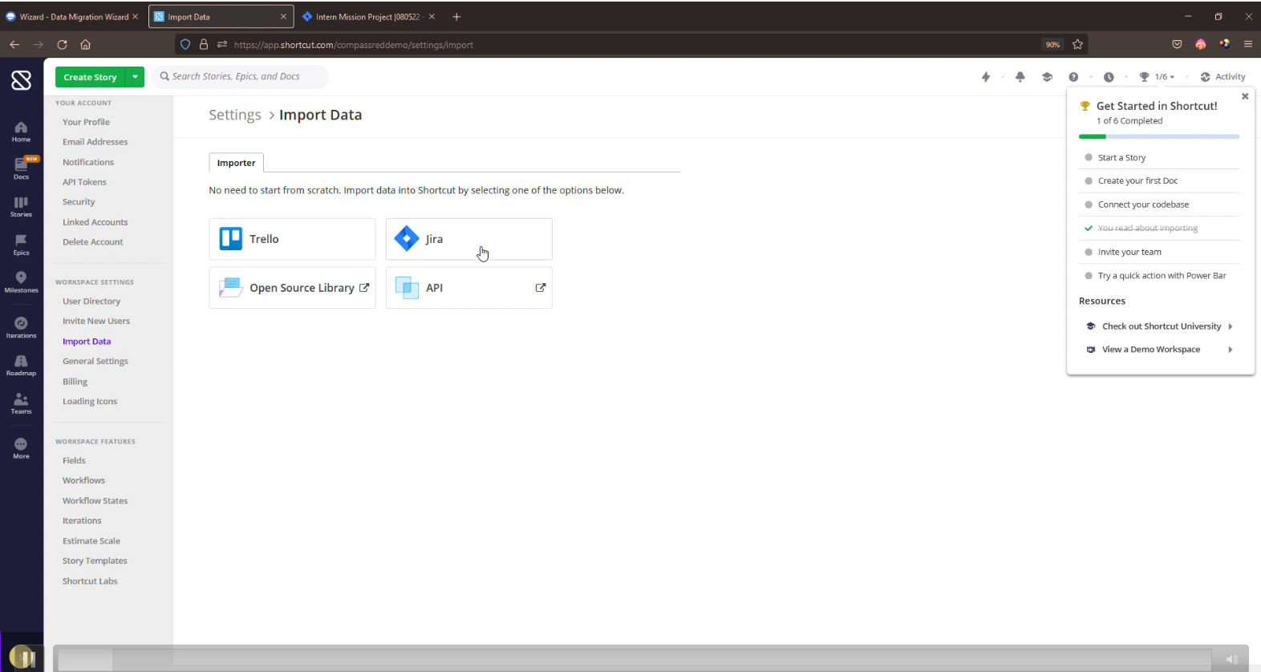
MIGRATION METHODS
IMPORT USING JIRA OR API

Slide 11
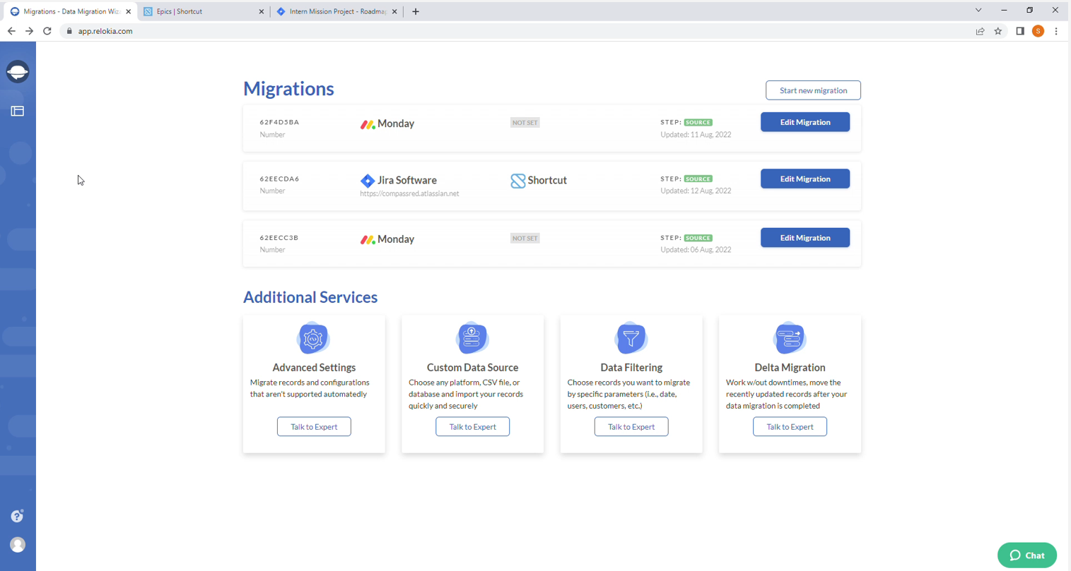
MIGRATION METHODS
IMPORT USING RELOKIA

Slide 12
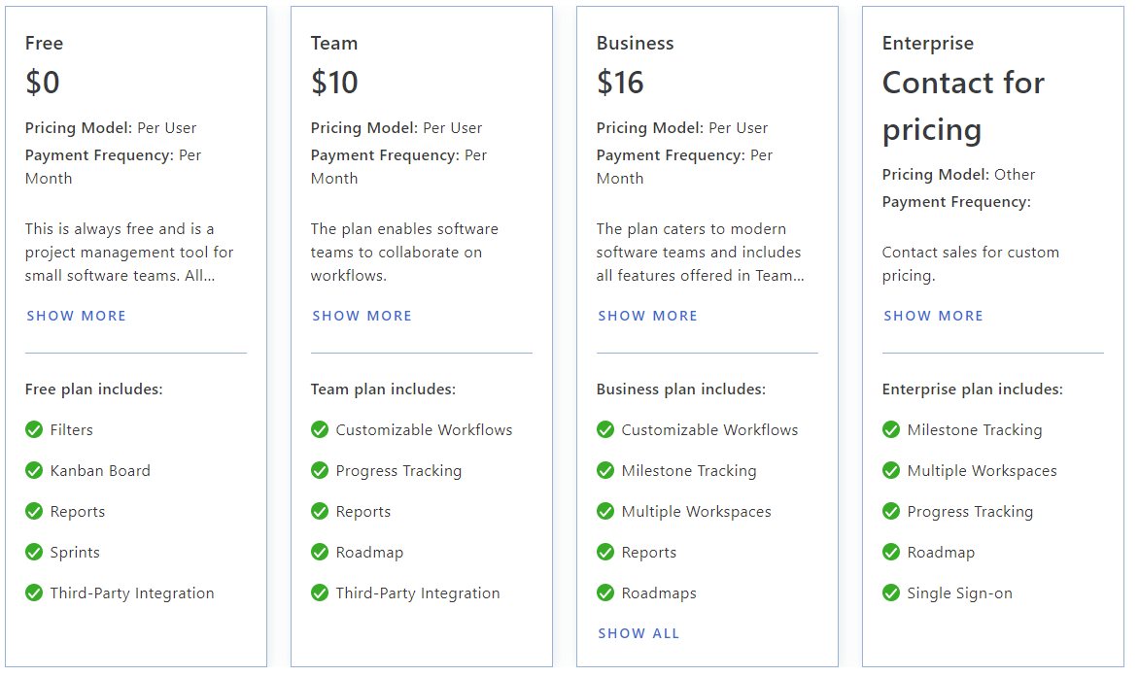
ABOUT THE TOOL
OVERVIEW AND PRICING OF THE TOOL

Slide 13
Thank You
Contact for more information.
Sunita Barik
E: Sunita.barik@compassred.com
P: 445.228.8665
13

